Slide 1
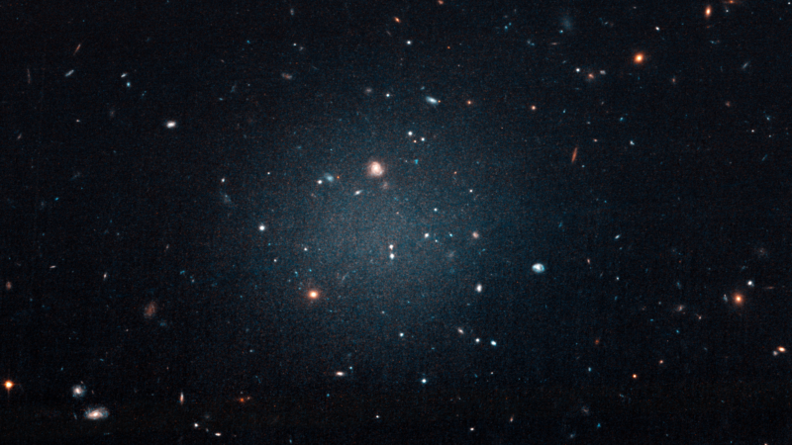
Dark Matter Models and Their Impact on Stellar Stream Morphology
Jack Kohm^{1,2}, Robyn Sanderson^{3,4}, Lisa Chien¹ Daniel Hey², Daniel Huber²
¹Department of Physics and Astronomy, Northern Arizona University, Flagstaff, AZ
²Institute for Astronomy, University of Hawai‘i, Honolulu, HI
³Department of Physics and Astronomy, University of Pennsylvania, Philadelphia, PA
⁴Center for Computational Astrophysics, Flatiron Institute, New York, NY

Slide 2
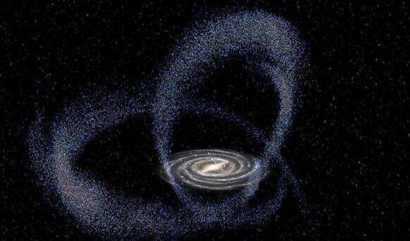
What are Stellar Streams?

Slide 3
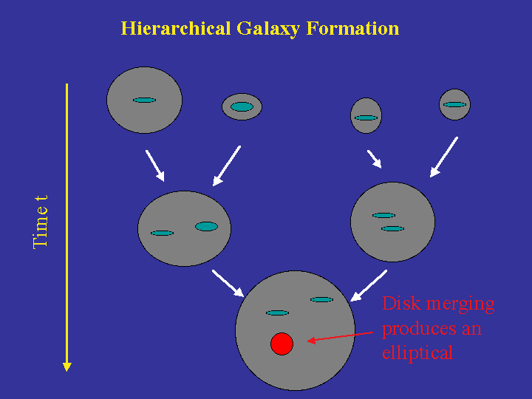
Tracers of Galactic Formation and Evolution

Slide 4
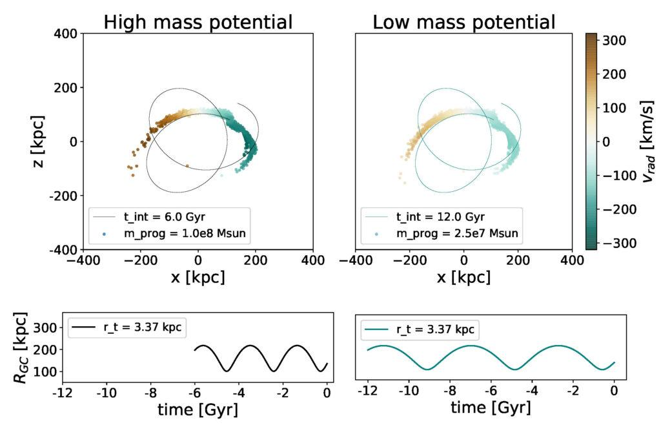
What is the use of stellar streams?
Stellar streams are sensitive probes of the gravitational potential

Slide 5
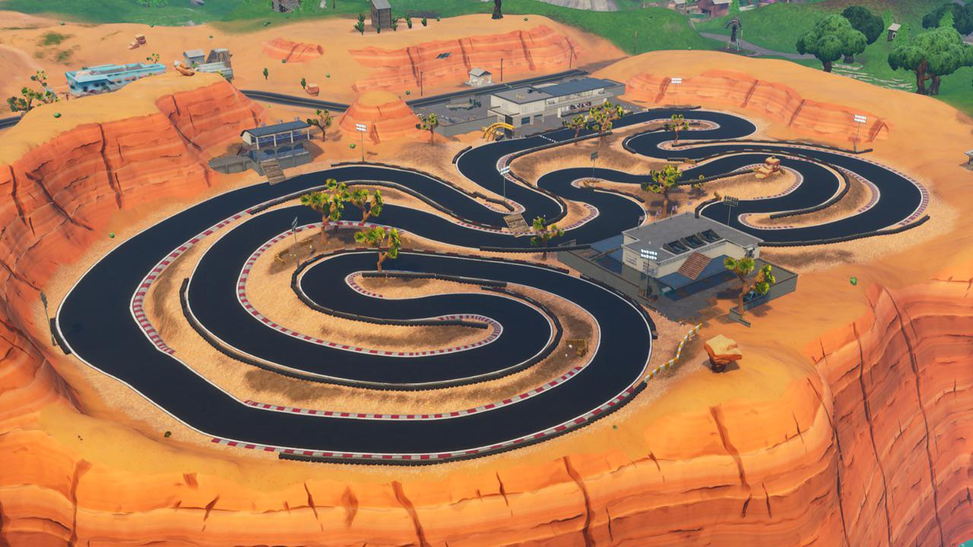

Slide 6
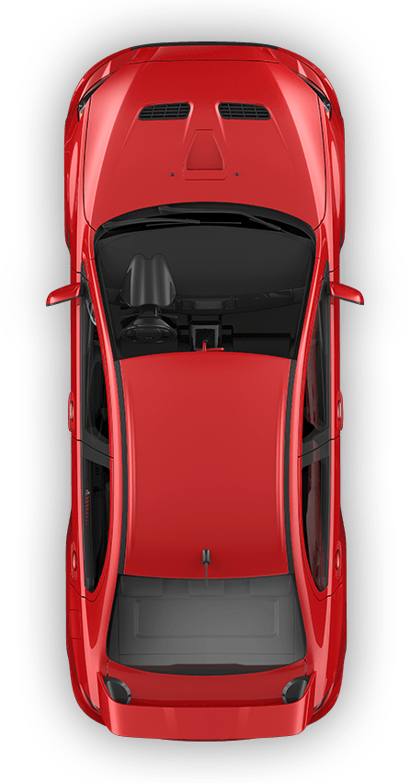

Slide 12
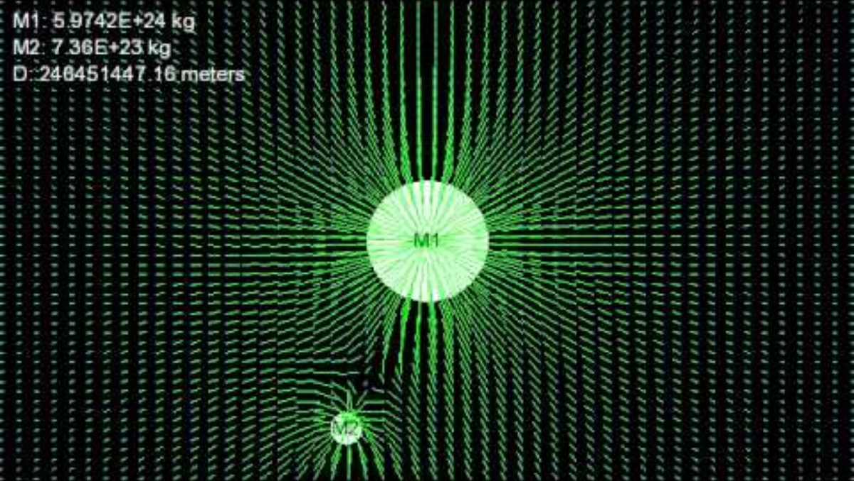
What makes these gravitational race tracks?

Slide 13
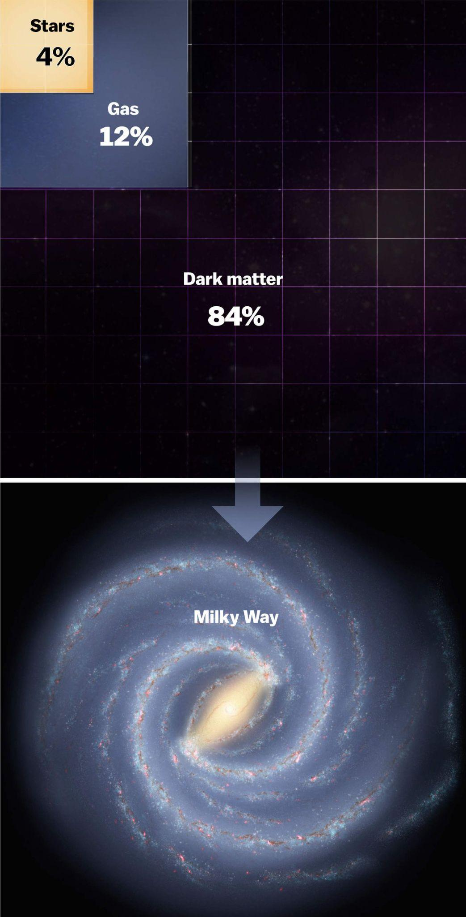
Gravitational Potential
Created by the presence of matter
Maps the distribution of mass in our galaxy

Slide 14
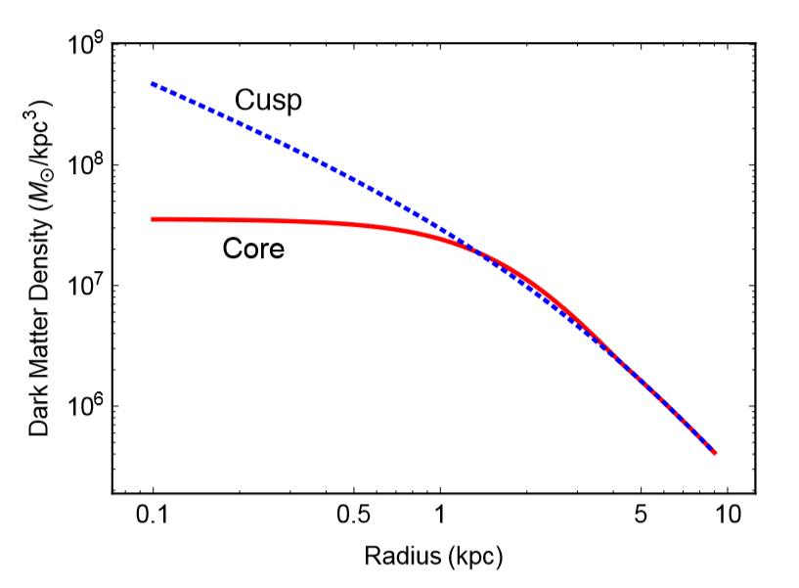
ΛCDM is extremely successful at large scale! Why Self Interacting Dark Matter?
On the Sub-galactic Scale
- - - CDM prediction
— Observed
Theory (CDM) prediction: cusp/NFW profile
Observations: cored isothermal profiles
(Tulin, 2017)
Notes:
Explain the core cusp problem showing that CDM halos in a NFW DM density profile fails to correctly describe observed dwarf galaxies with cored densities and how SIDM can give you the cored profiles we see in dwarf galaxies and still also produce NFW like density profiles of galaxies with a larger stellar mass and when including the effect of baryons around a type of dark matter that can efficiently thermalize through having interactions with itself beyond gravitational only interactions an array of different DM density profiles can show up.

Slide 15
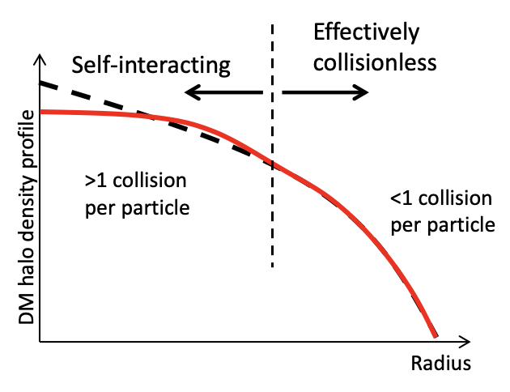
ΛCDM is extremely successful at large scale! Why Self Interacting Dark Matter?
Probability of DM self interactions depend on density, large scale structure stays consistent with CDM.
SIDM leaves ΛCDM intact where it works best and universally consistent in describing structure on all scales.
(Tulin, 2017)
Notes:
Explain the core cusp problem showing that CDM halos in a NFW DM density profile fails to correctly describe observed dwarf galaxies with cored densities and how SIDM can give you the cored profiles we see in dwarf galaxies and still also produce NFW like density profiles of galaxies with a larger stellar mass and when including the effect of baryons around a type of dark matter that can efficiently thermalize through having interactions with itself beyond gravitational only interactions an array of different DM density profiles can show up.

Slide 16
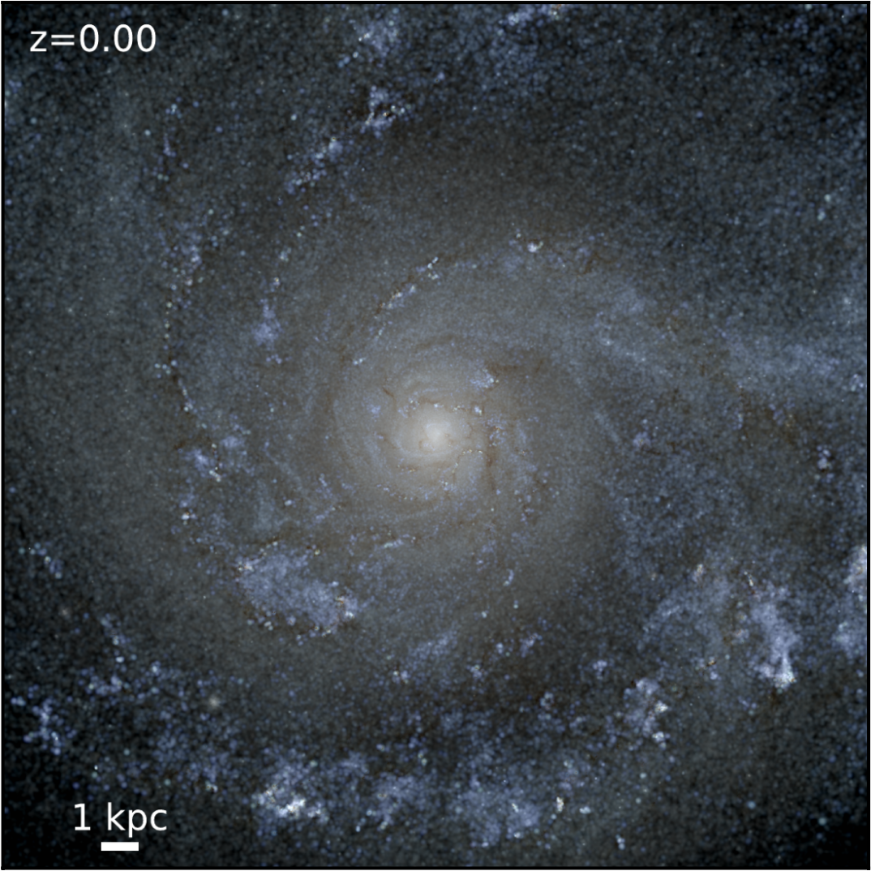
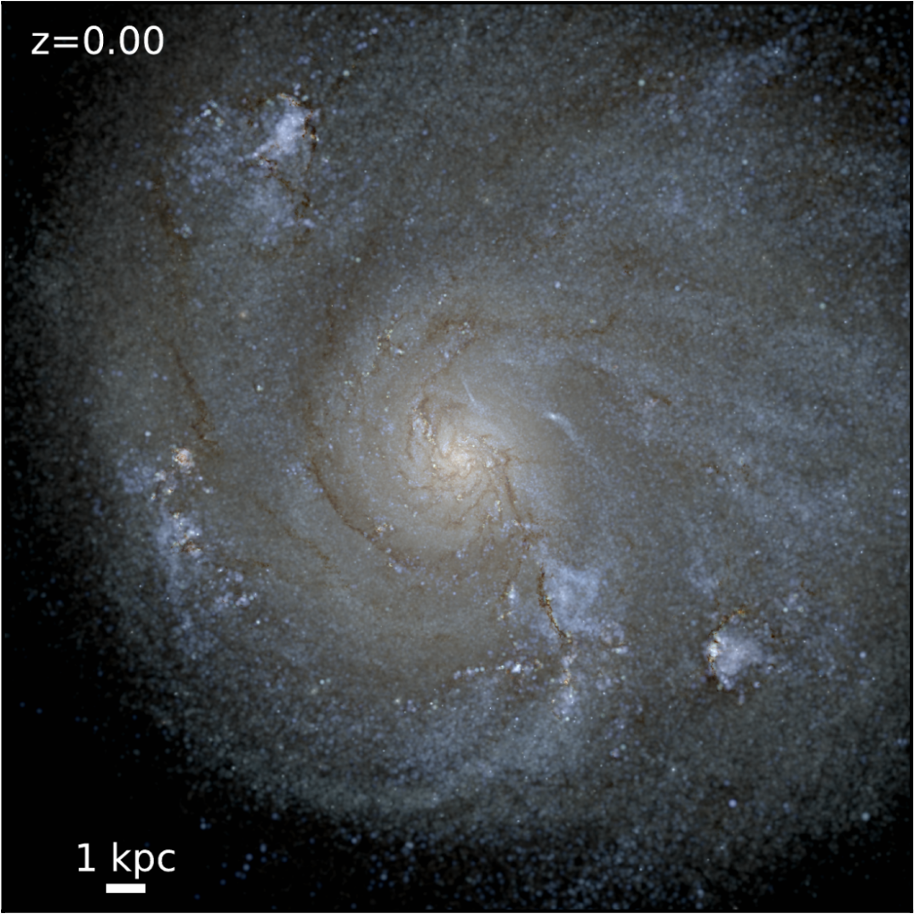
Feedback In Realistic Environments (FIRE-2) Cosmological Simulations (Hopkins et.al)
Latte suite of MW-mass galaxies (Wetzel et.al)
m12i CDM
m12i SIDM1
Realistic Baryonic Physics:
Mesh free finite mass hydrodynamics
Cooling, star formation, and stellar feedback mechanisms.
(Vargya et.al 2022)
(Vargya et.al 2022)
Notes:
Explain the physics of the FIRE suite and how it can resolve up to 1pc resolution while including supernovae feedback stellar winds, hydrodynamics, stellar ages and metallicites.

Slide 17
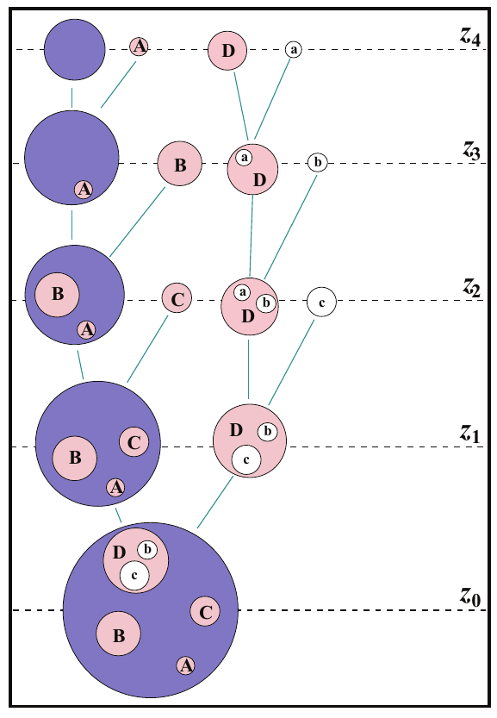
How do we isolate satellites that have not fully merged into the main galaxy at z = 0?
Halo Finders
Halo merger trees often lose track of subhalos for multiple snapshots during pericenter of orbit.
Uses 6D phase space information to find halos
Problem:
Halo finders tend to fail at tracking satellites near the pericenter of their orbit
Halo merger tree

Slide 18
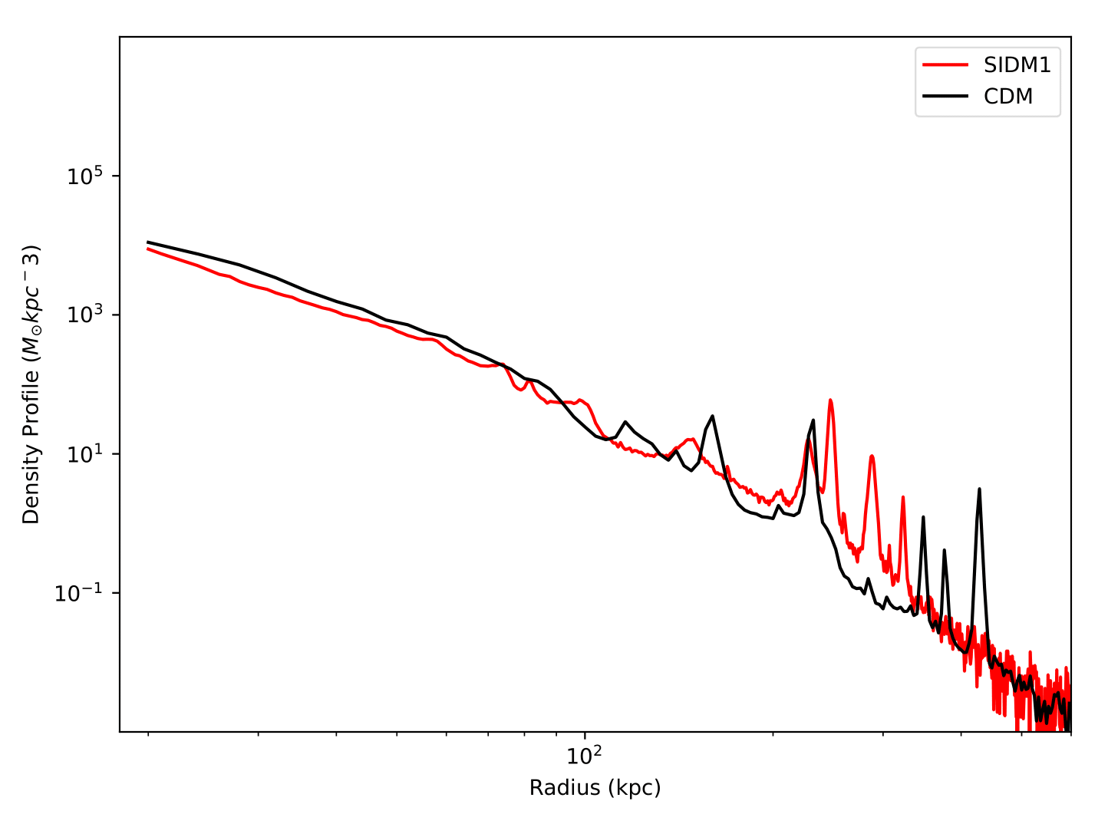
Stellar density profile with satellites at z = 0

Slide 19
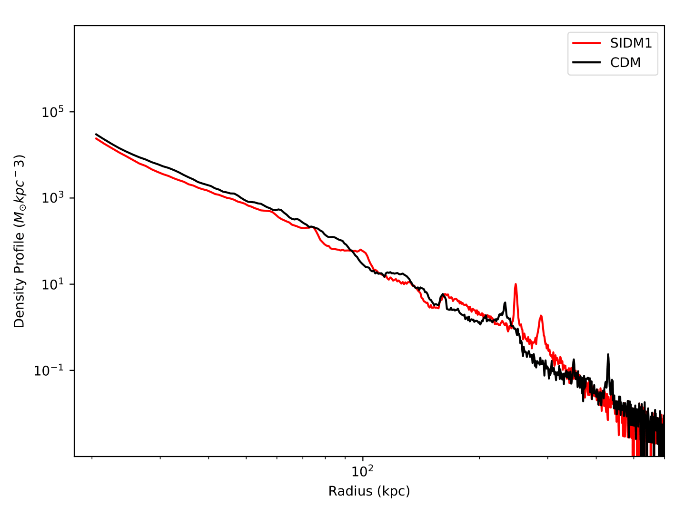
Removal of satellites at z = 0
Peaks!
Halo finder fails to find all halos in z = 0 snapshot

Slide 20
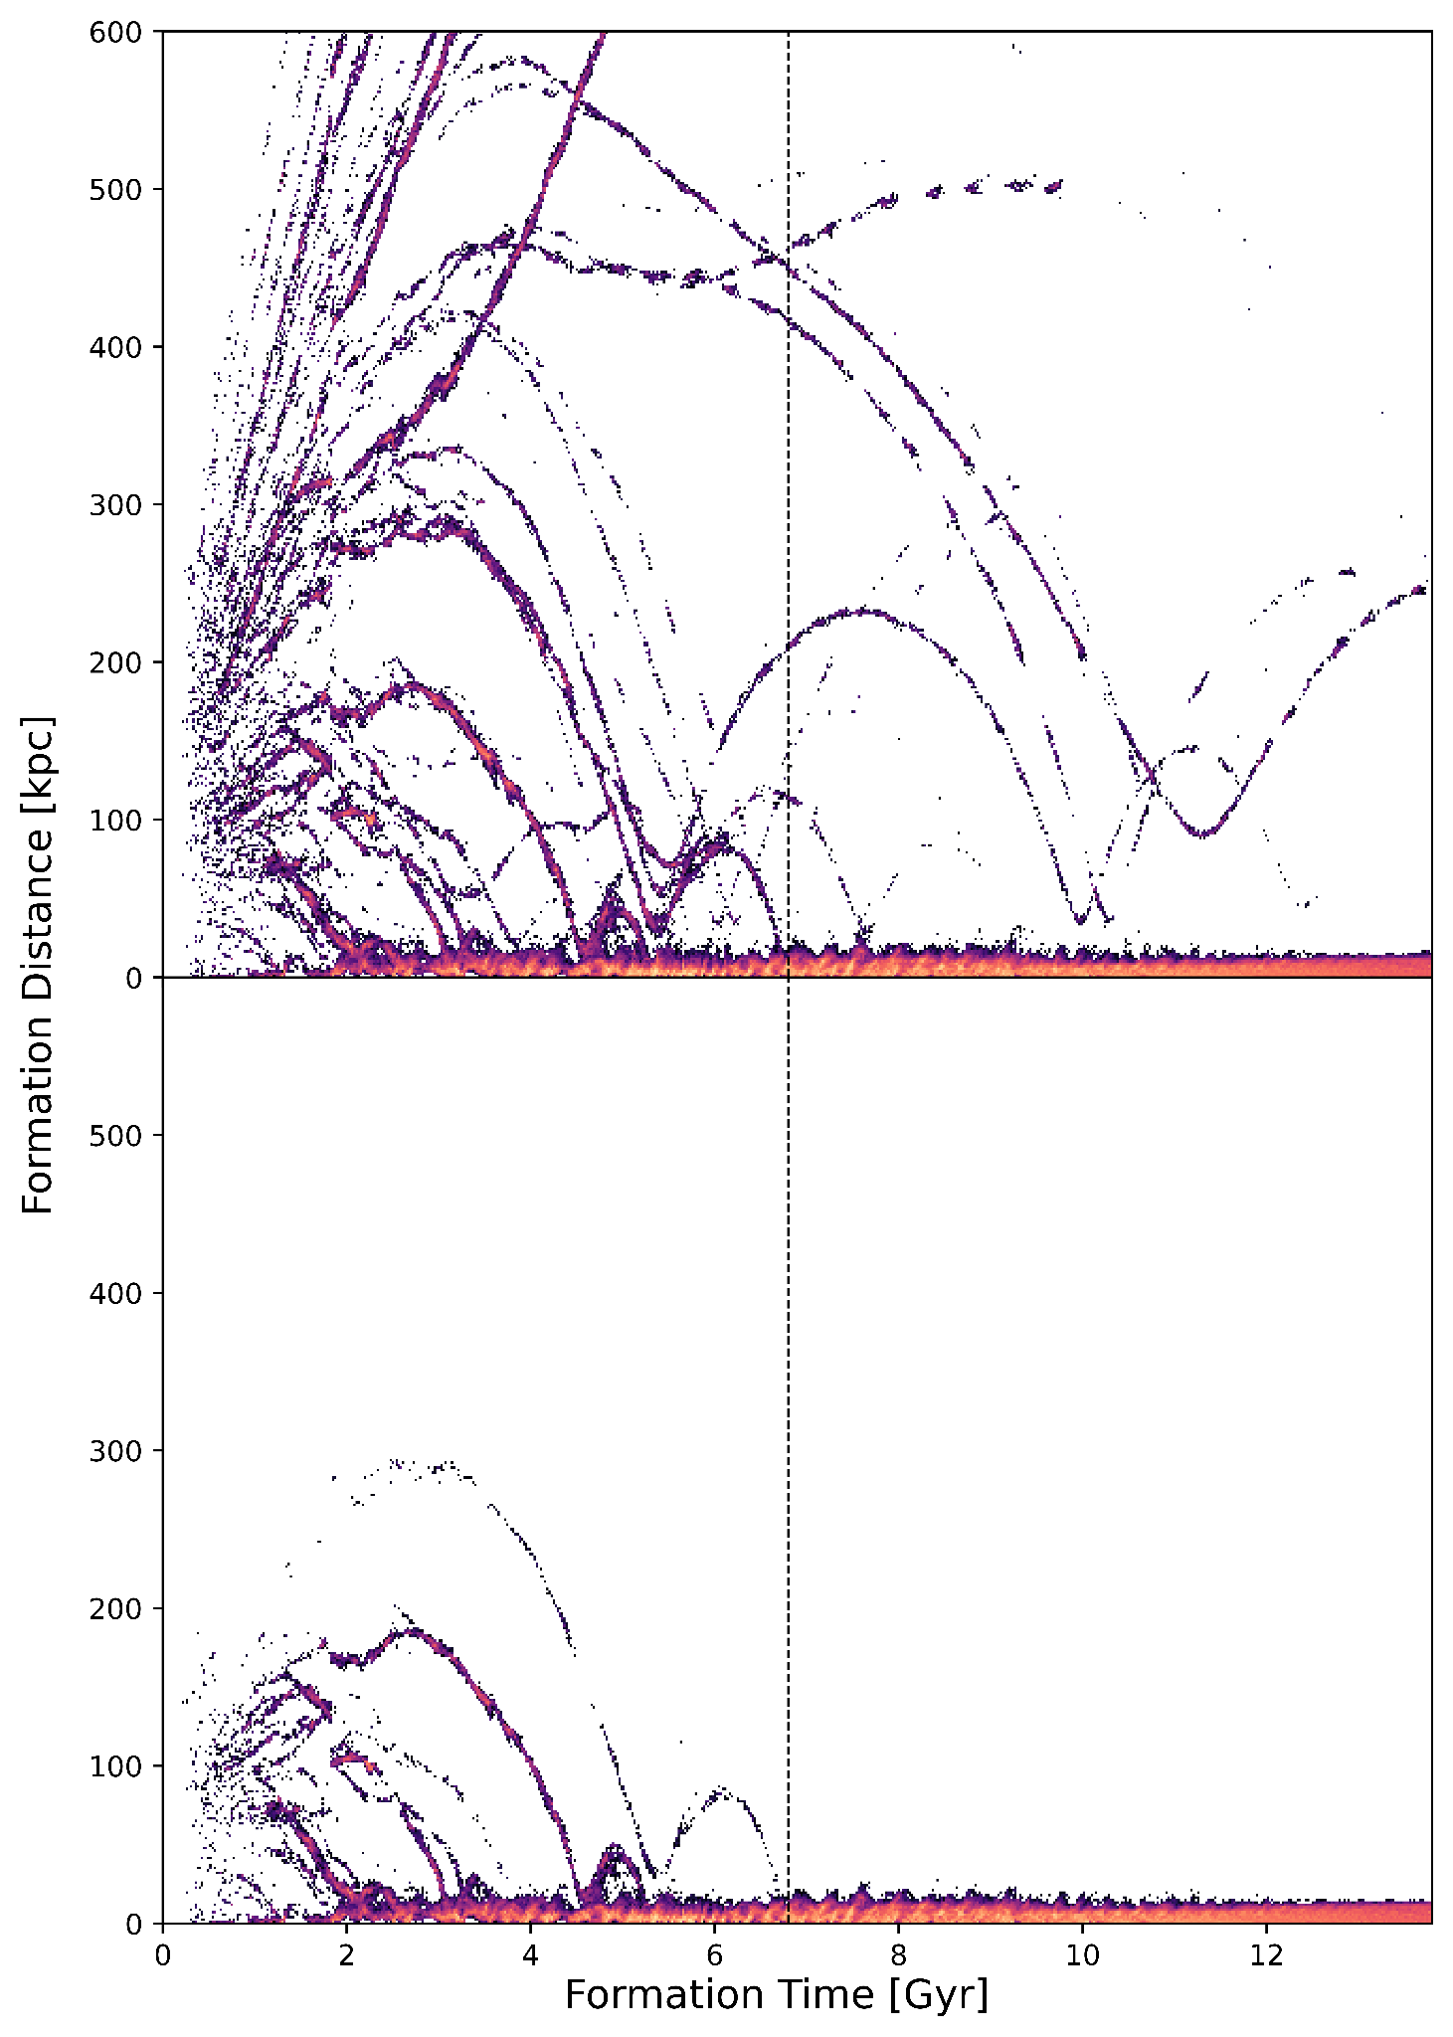
Formation of star particles in cosmic time vs radial distance to the galactic center
Birth radii of all star particles to 800 kpc
Satellites that have not fully merged into the central region of the galaxy at present day (Stellar Stream Candidates)
Birth radii of stars that fully merge into the galactic bulge and disk at z = 0
Using a union-find algorithm we supplemented the rockstar halo finder to retain star particle information of highly disrupted halos

Slide 21
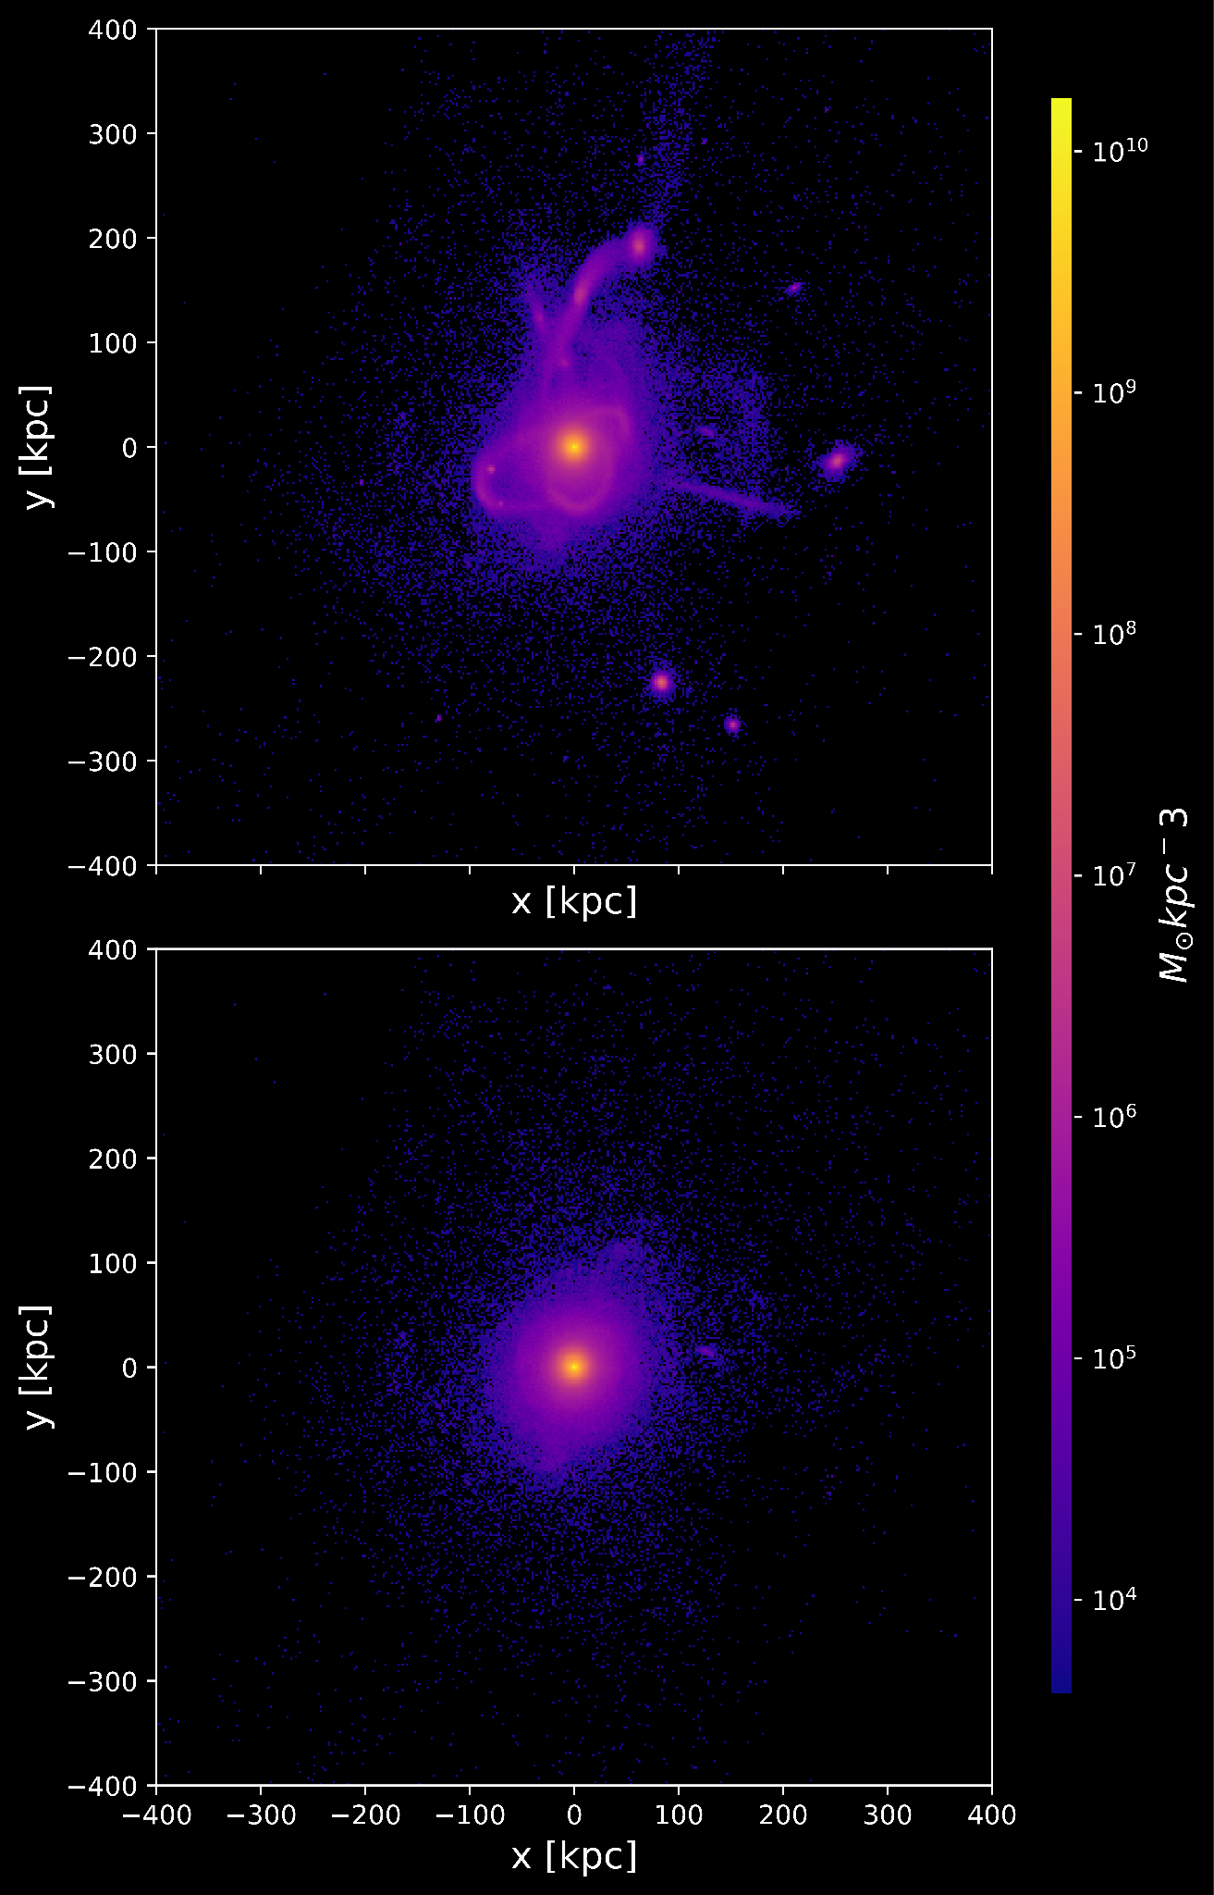
Isolated stellar halo
Notes:
Explain the process of isolating Satellites that havent merged into the bulge and tracking halos to infall
Show the dform tform of the milky way disk and bulge and isolation of all satellites that haven’t fully merged into it being isolated.
Briefly explain issues with using merger trees and the solution being the satellite removal pipeline and how it combines similar halos throughout each snapshot.

Slide 22
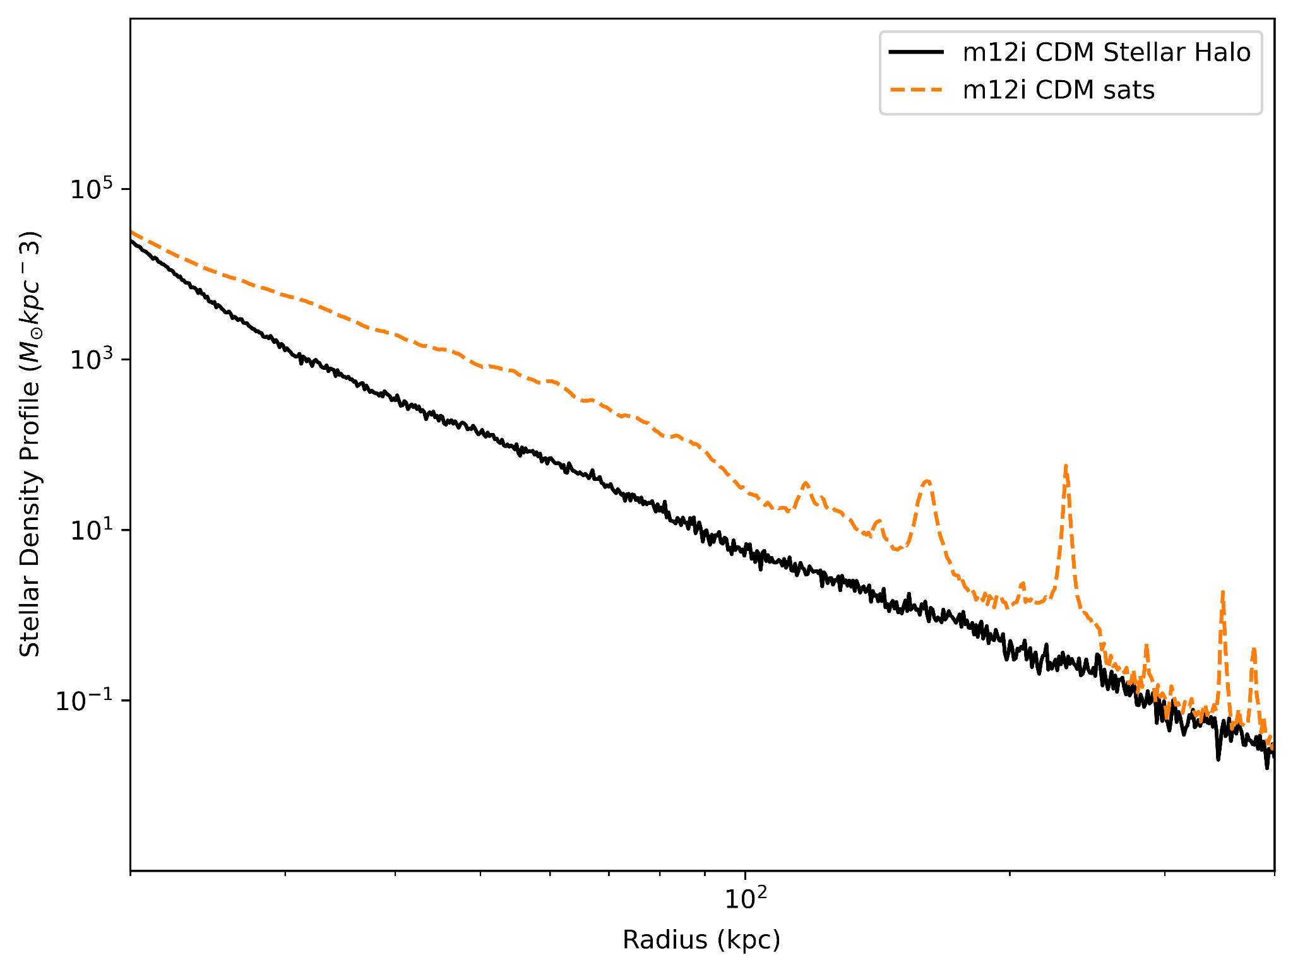
Power Law

Slide 23
Characterization of Streams
Mass
Length
Coherence
(1)
(2)
(3)
120 (Orphan stream)
<
# of star particles
<
10⁵ (Sag DSph)
Local velocity dispersions (𝜎) that fall below the median local velocity dispersion for phase coherence
Pairwise separation between any two star particles in the group is greater than 120 kpc
(Panithanpaisal et al. 2021)
Notes:
We use the criteria from (Panithanpaisal et al. 2021) to classify the satellites isolated from the pipeline into streams, the three criteria that have to be satisfied for a accreted satellite galaxy to form a stream at present day is
We put a star particle number constraint to keep the streams within the mass range of streams we observe in the milky way where the lower mass limit corresponds to the orphan stream 120 star particles and the upper mass limit corresponding to sagittarius-mass dwarfs 10^5 star particles
We calculate the distance between star particles from the accreted satellites at present day and ensure that the pairwise separation between any two star particles in the group is greater than 120 kpc
We calculate the local velocity dispersion using a equation from (Panithanpaisal et al. 2021) (insert equation) and keep stream candidates that have local velocity dispersions (sigma) that fall below the median local velocity dispersion for phase coherence in equation (label) This allows us to separate out phase mixed candidates from coherent stellar streams.

Slide 24
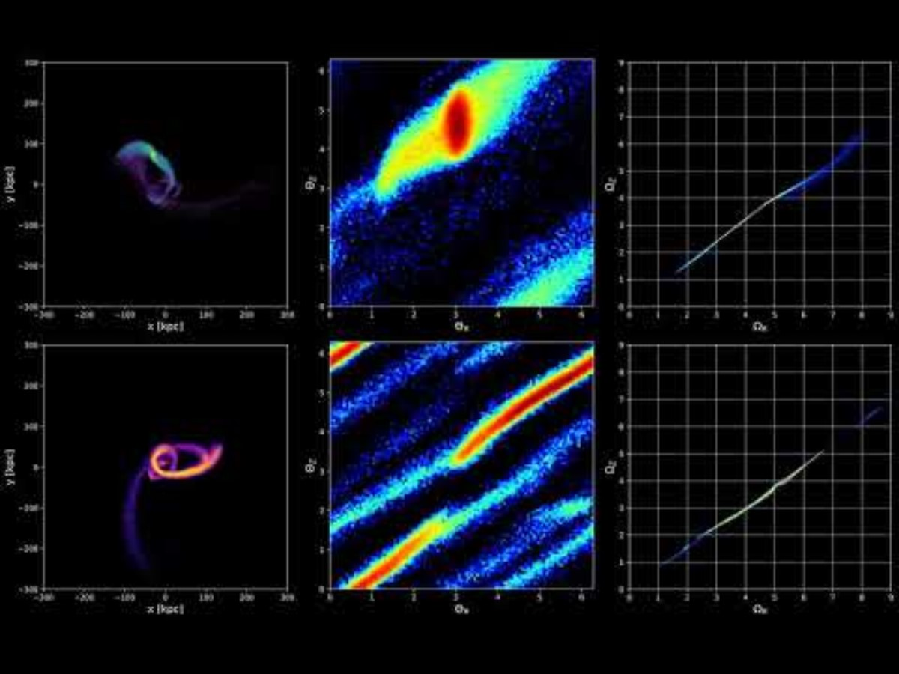
Cold
Dark
Matter
(CDM)
Self
Interacting
Dark Matter
(SIDM

Slide 25
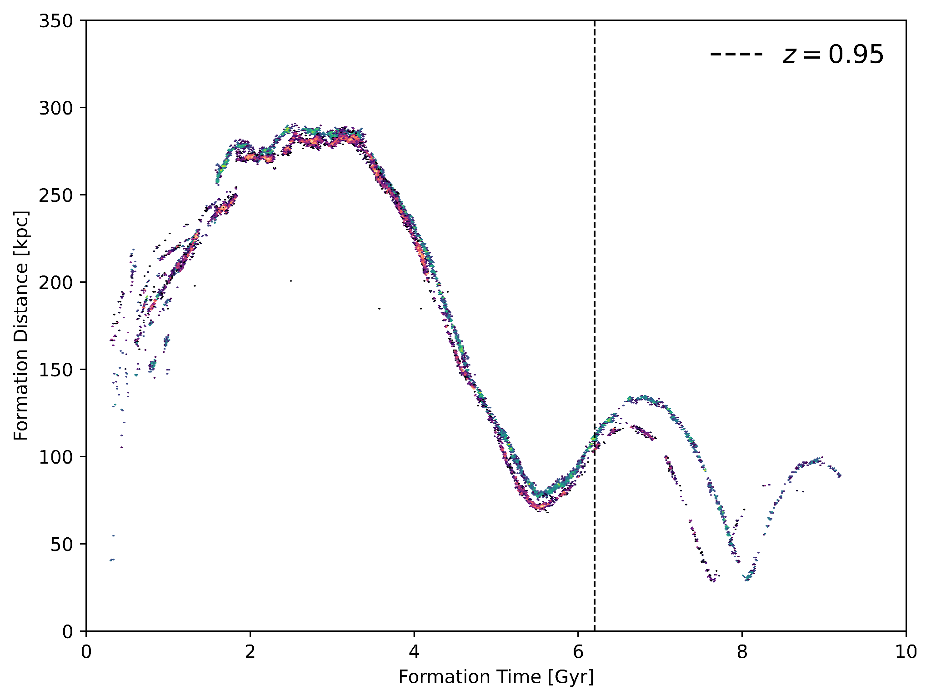
CDM
SIDM
Speed of the tidal disruption process sets the lower limit of the stellar age distribution of a stream
Quenching of star formation
Notes:
Show dform/tform of just the satellite evolving through time and the cutoff where star formation happens at a slower rate. And the dm density profiles alongside them. How age distribution tracks the central DM density and divergence of both streams aligns with the diverging DM density profiles

Slide 26
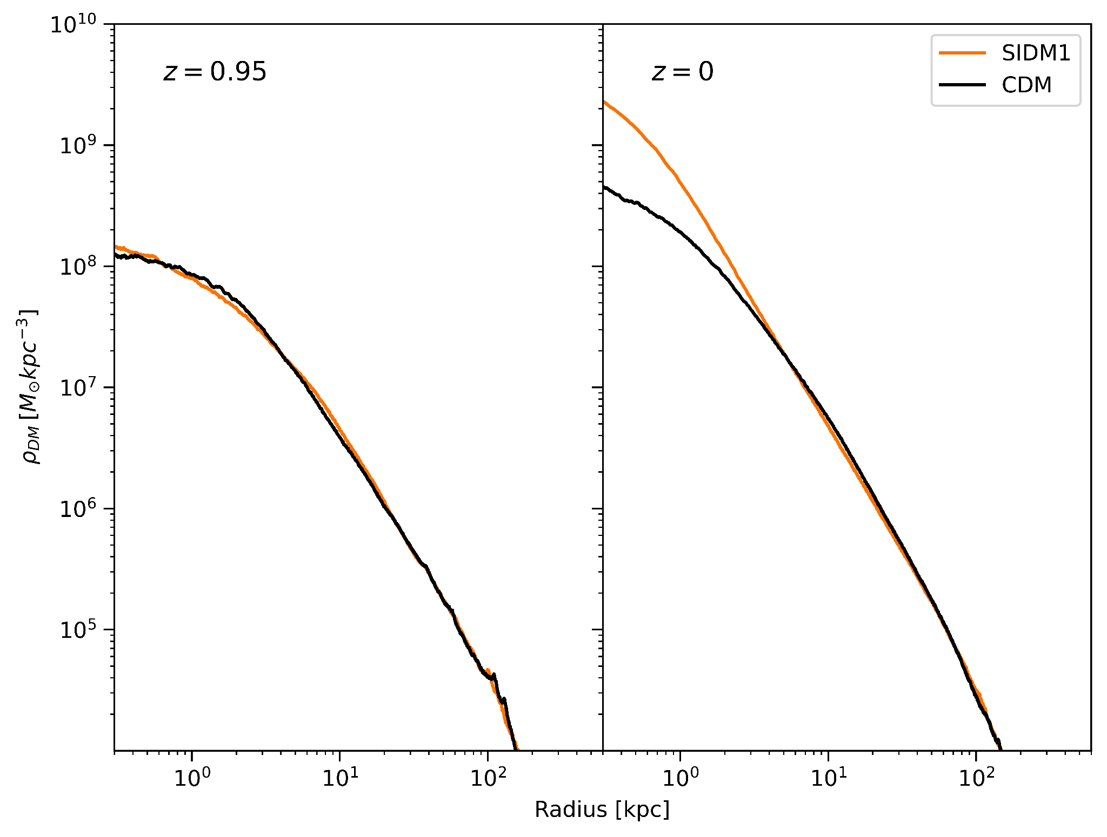
Central DM density of Host Halo
Divergence of infalling satellite paths follow the divergence of central DM density profiles

Slide 27
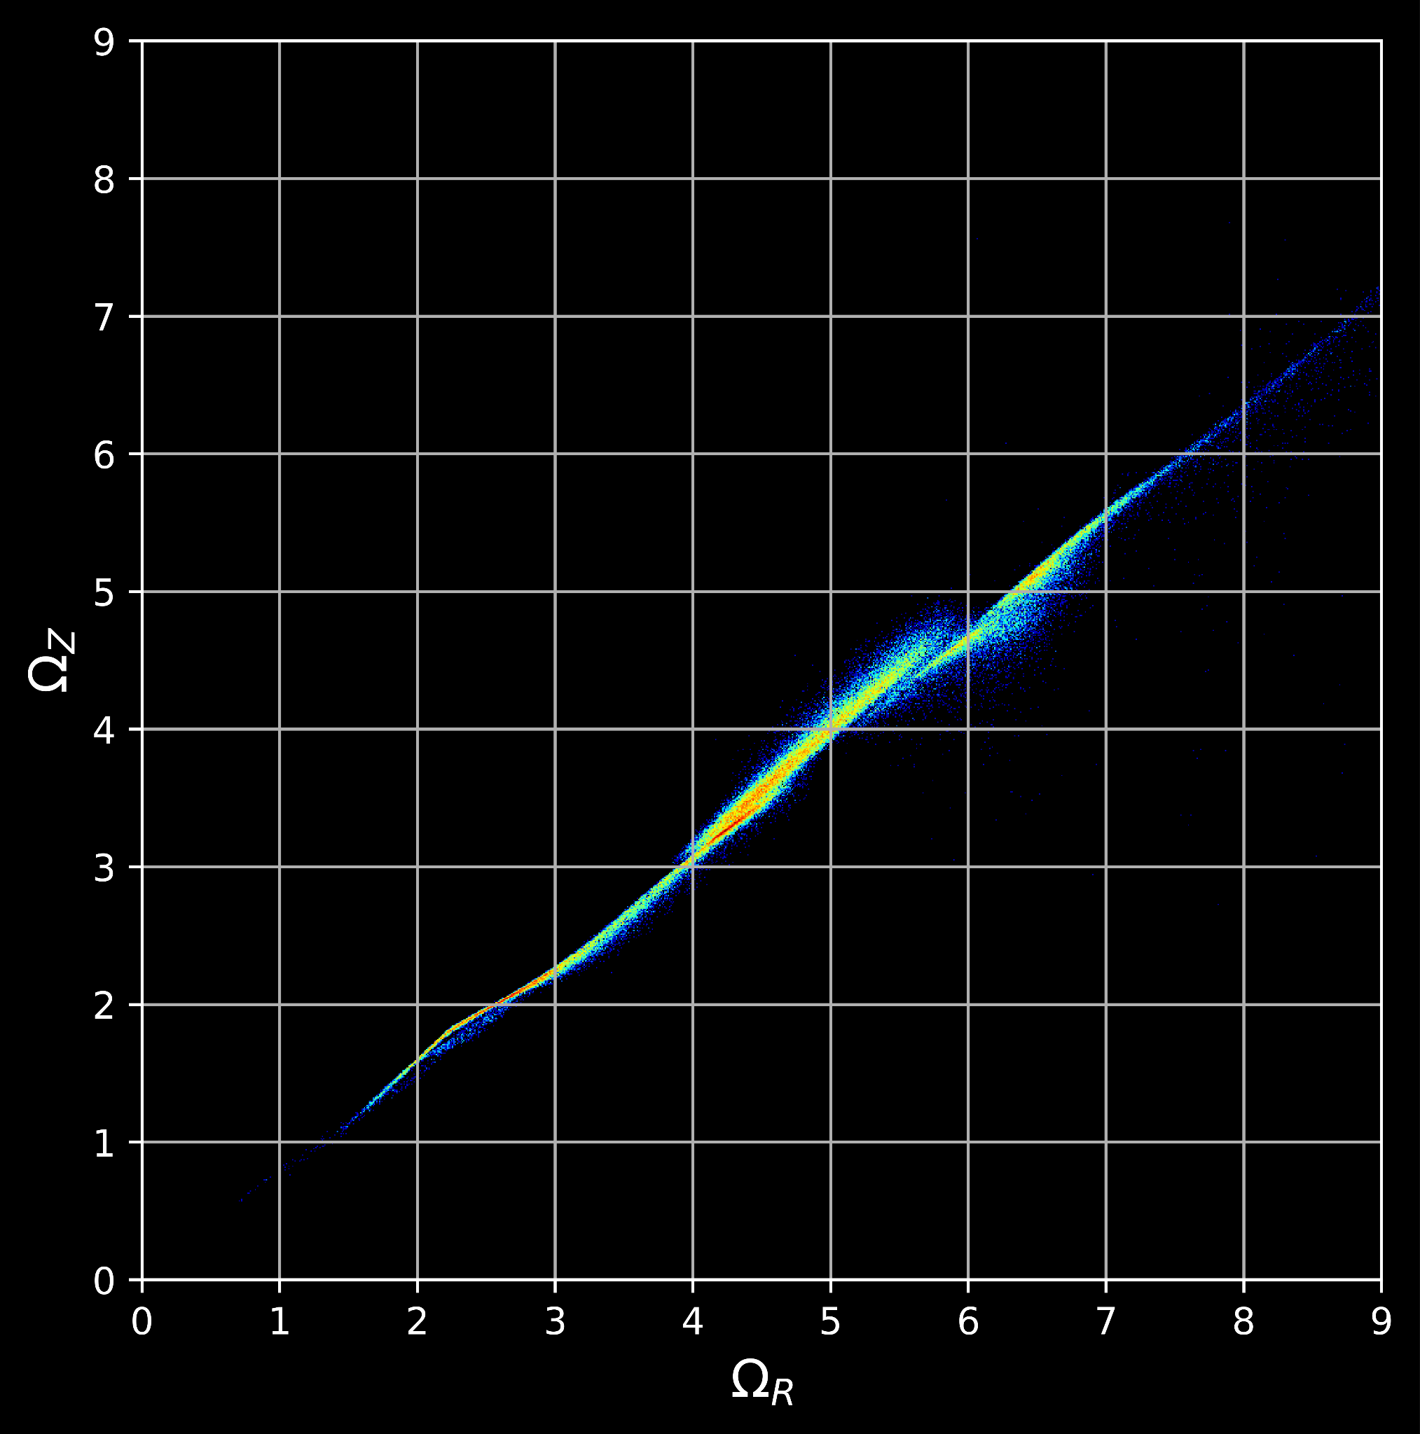
CDM MW-mass (m12i)
Both streams displayed potential resonance trapping. The regions of resonance are closely tied to the gravitational potential, which varies with the underlying dark matter model. This variation alters the potential to support different orbital families at distinct energies and angular momenta.
There is a distinct gap in frequency space at 5:4 (Ω_{R} : Ω_{Z}) in snapshot 483 in which the resonance occurs.
The SIDM stream experiences a similar resonance at 4:3 (Ω_{R} : Ω_{Z}) ratio
Notes:
explain how nbody simulations were able to make predictions about the kinematics of stellar streams and briefly introduce looking at these streams in action angle space to show that even through giving a prescription of a potential we can uncover the true potential through alignment in the angle and frequency phase spaces.

Slide 28
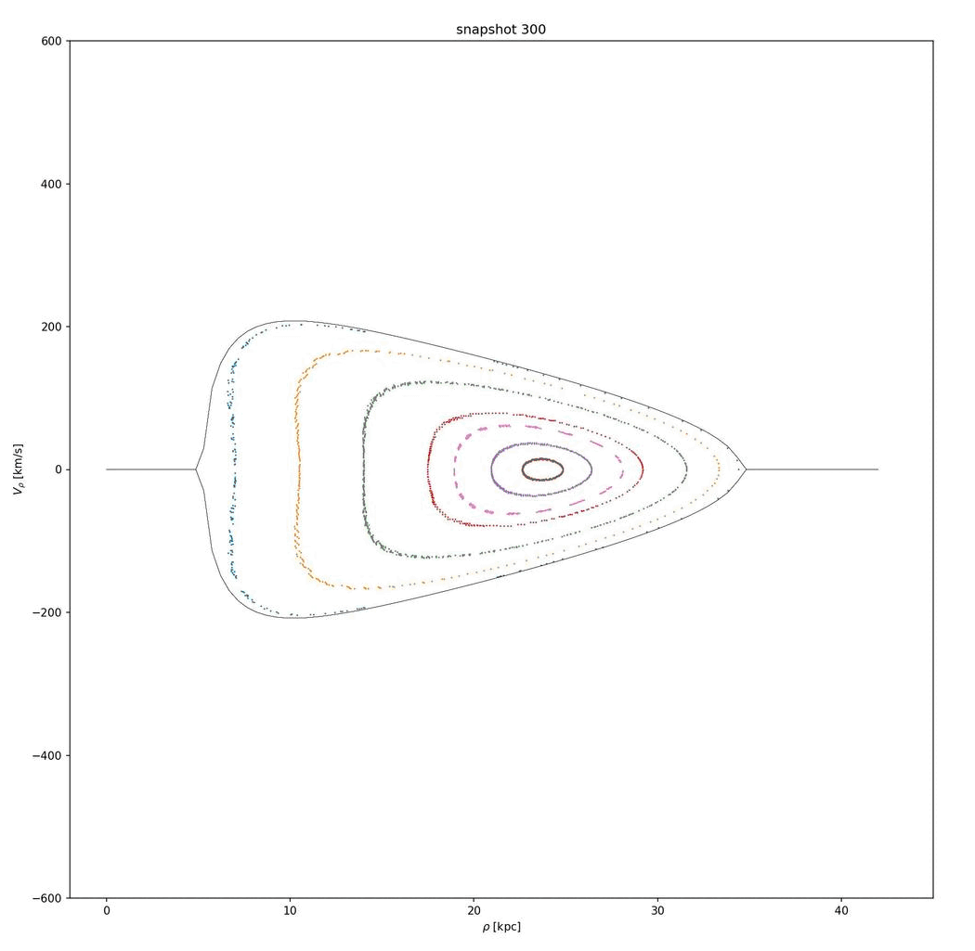

Slide 29
Acknowledgements
Thank you to:
  Lisa Chien
  Robyn Sanderson, Nondh Panthanpaisal, Arpit Arora, Adrien Thob and the UPenn Undergrads
  IfA Mentors Daniel Hey, Daniel Huber
  NSF, IfA, REU Directors, REU students
  NASA Space Grant and Paloma Davidson

Slide 30
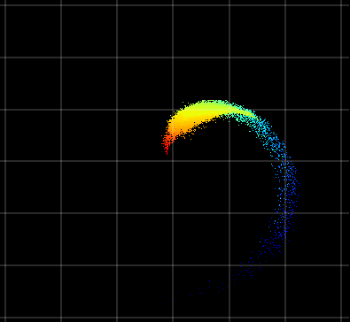
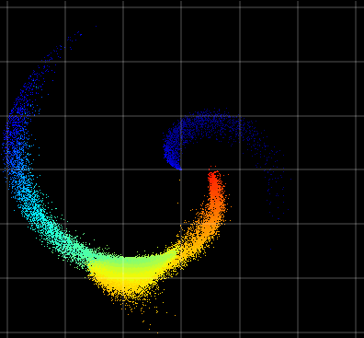
Summary
Tracking star particles in halos/stream progenitors through all timesteps of a cosmological simulation captures star formation history and loosely bound into further stages of tidal disruption
Stellar streams in CDM and SIDM can vary in their age distributions due to tidal quenching of star formation due to gravothermal core contraction from the thermalization of SIDM
Stellar stream resonances can serve as tracers for the evolution of the gravitational potential and its time dependent nature

